Slide 1


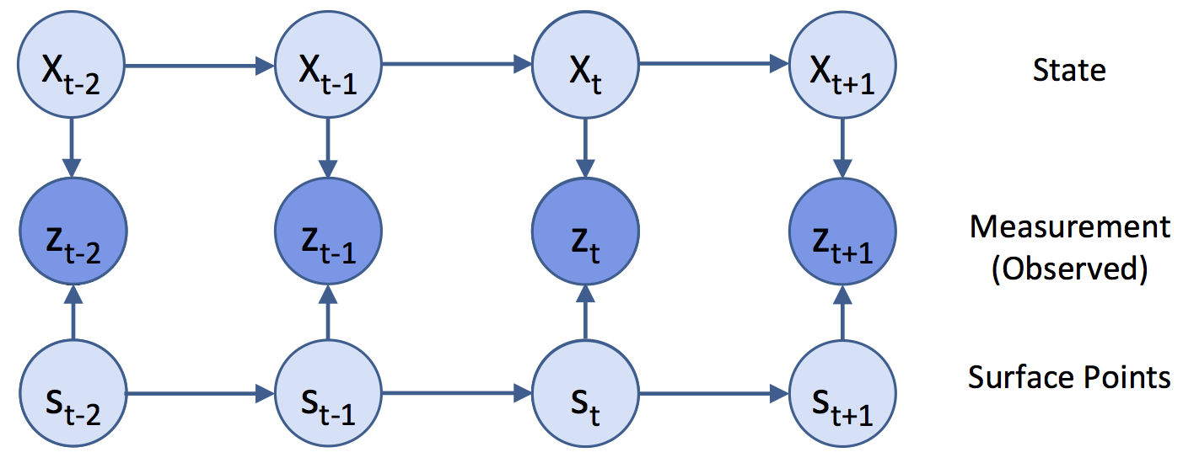
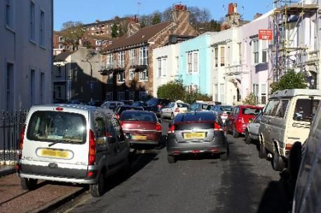
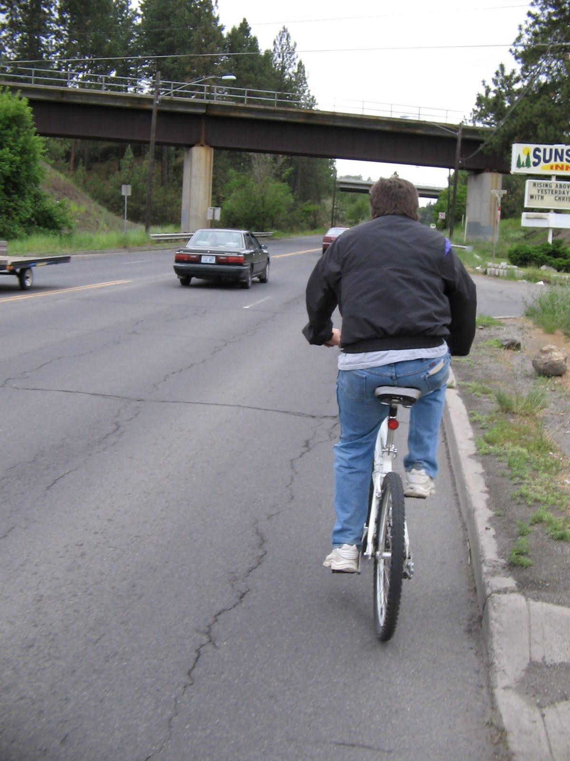
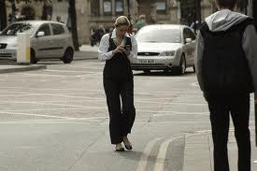
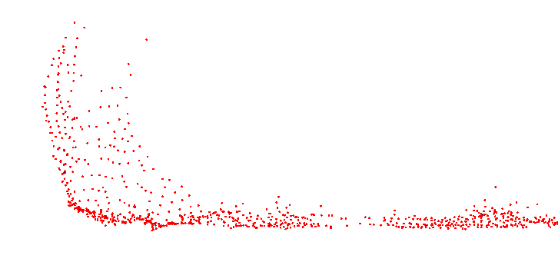
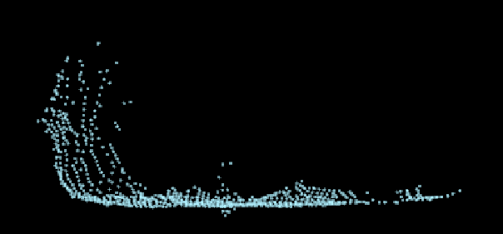
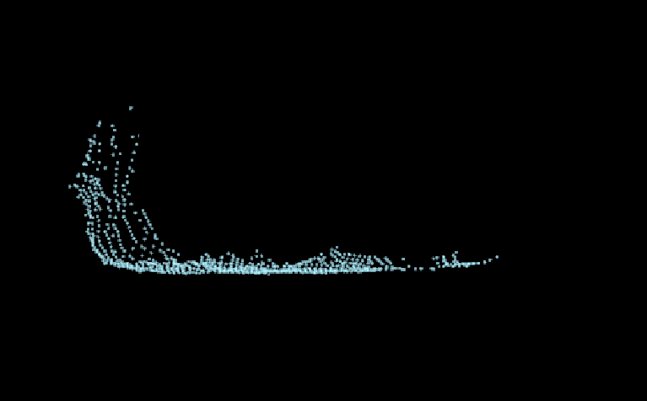
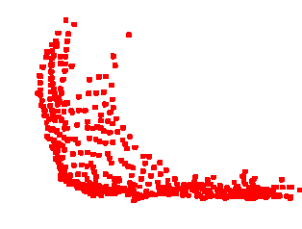
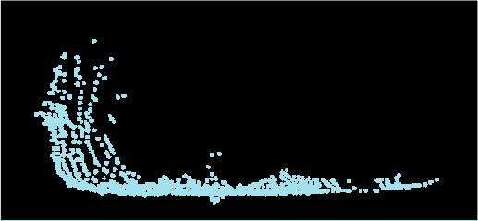
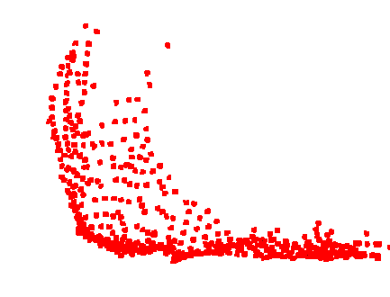
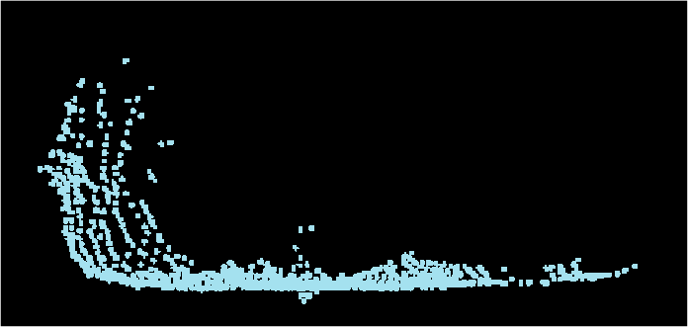

Combining 3D Shape, Color, and Motion
for Robust Anytime Tracking
David Held, Jesse Levinson, Sebastian Thrun, and Silvio Savarese
Goal: Fast and Robust Velocity Estimation
Our Approach: Alignment Probability
P₁
P₂
Annealed Dynamic Histograms
P₃
P₄
Spatial Distance
Color Distance (if available)
Probability of Occlusion
Notes:
\left p(x_t \mid z_1 \ldots z_t) = \eta \, p(z_t \mid x_t, z_{t-1}) p(x_t \mid z_1 \ldots z_{t-1})

Slide 2
Combining 3D Shape, Color, and Motion
for Robust Anytime Tracking
David Held, Jesse Levinson, Sebastian Thrun, and Silvio Savarese
Goal: Fast and Robust Velocity Estimation
Baseline: Centroid Kalman Filter
t+1
t
Annealed Dynamic Histograms
Occlusions
Actual Motion
Baseline: ICP
Local Search Poor Local Optimum!

Slide 3
Combining 3D Shape, Color, and Motion
for Robust Anytime Tracking
David Held, Jesse Levinson, Sebastian Thrun, and Silvio Savarese
Goal: Fast and Robust Velocity Estimation
Our Approach: Alignment Probability
P₁
P₂
Annealed Dynamic Histograms
P₃
P₄
Spatial Distance
Color Distance (if available)
Probability of Occlusion

Slide 4
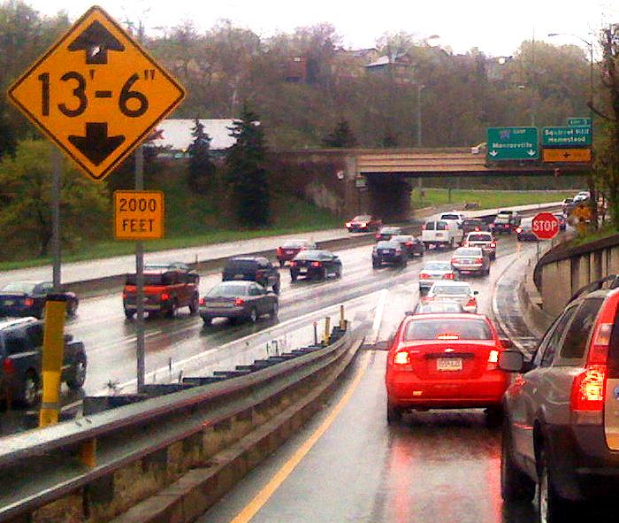
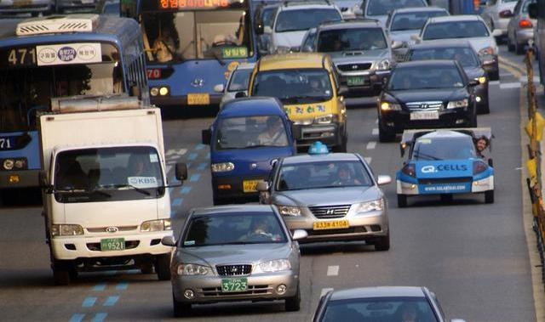
Motivation
Quickly and robustly estimate the speed of nearby objects
Notes:
Show videos - cars converging onto a lane, bikes swerving into traffic

Slide 5
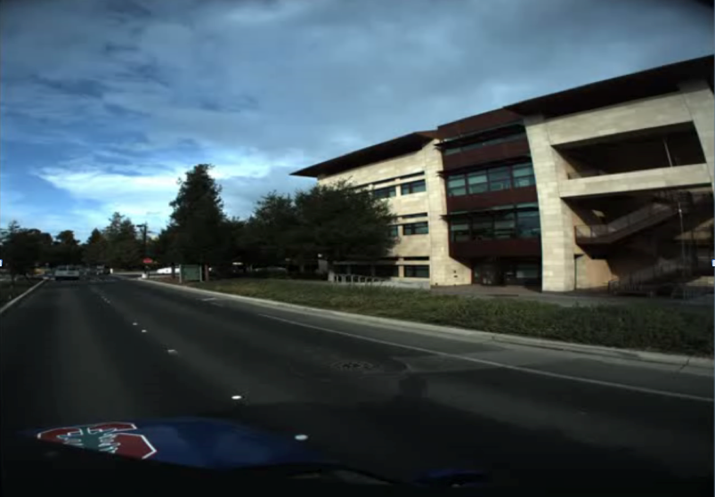
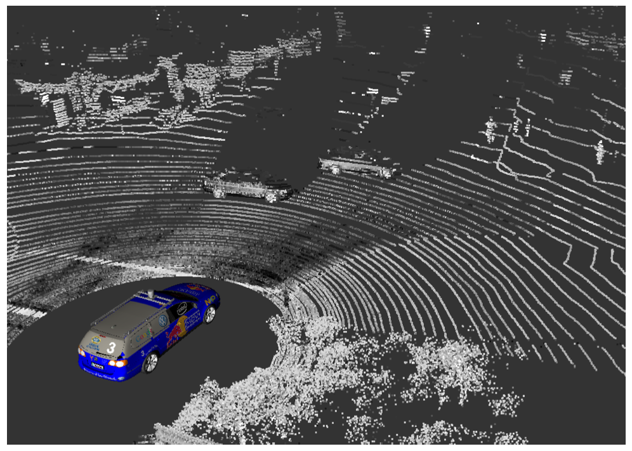
System
Camera Images
Laser Data

Slide 6


System
Camera Images
Laser Data
Previous Work
(Teichman, et al)

Slide 7
System
Camera Images
Velocity
Estimation
Laser Data
This Work
Previous Work
(Teichman, et al)

Slide 8
Velocity Estimation
t

Slide 9
Velocity Estimation
t+1
t

Slide 10
Velocity Estimation
t+1
t

Slide 11
Velocity Estimation
t+1
t

Slide 12
Velocity Estimation
t+1
t
Occlusions
Actual Motion

Slide 13
ICP Baseline

Slide 14
ICP Baseline

Slide 15
ICP Baseline

Slide 16
ICP Baseline

Slide 17
ICP Baseline
Local Search Poor Local Optimum!

Slide 18
Tracking Probability

Slide 19
Velocity Estimation
t

Slide 20
Velocity Estimation
t+1
t

Slide 21
Velocity Estimation
t+1
t

Slide 22
Velocity Estimation
t+1
t

Slide 23
Velocity Estimation
t+1
t

Slide 24
Velocity Estimation
t+1
t

Slide 25
Velocity Estimation
t+1
t
X_{t}

Slide 26
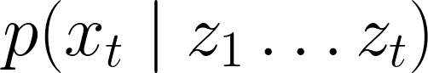
Velocity Estimation
t+1
t
X_{t}

Slide 27
Tracking Probability
Measurement
Model
Motion Model
Notes:
\left p(x_t \mid z_1 \ldots z_t) = \eta \, p(z_t \mid x_t, z_{t-1}) p(x_t \mid z_1 \ldots z_{t-1})

Slide 28
Tracking Probability
Measurement
Model
Motion Model
Constant velocity Kalman filter

Slide 29
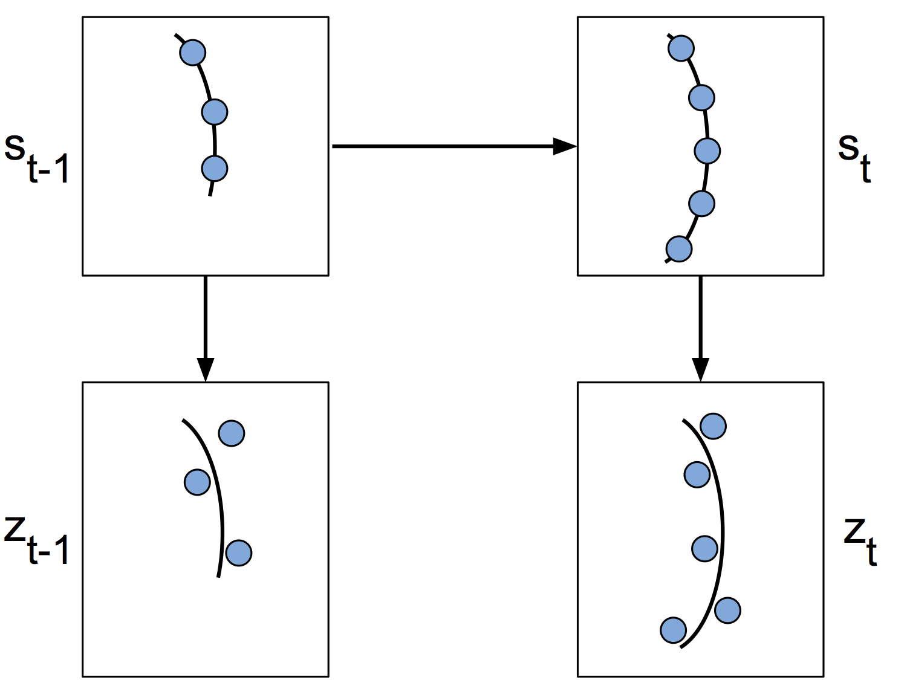
Tracking Probability
Measurement
Model
Motion Model

Slide 30
Tracking Probability
Measurement
Model
Motion Model

Slide 31
Tracking Probability
Measurement
Model
Motion Model

Slide 32
Tracking Probability
Measurement
Model
Motion Model

Slide 33
Tracking Probability
Measurement
Model
Motion Model

Slide 34
Tracking Probability
Measurement
Model
Motion Model

Slide 35
Tracking Probability
Measurement
Model
Motion Model

Slide 36
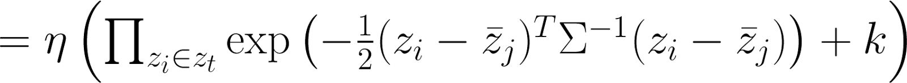
Tracking Probability
Measurement
Model
Motion Model

Slide 37
Tracking Probability
Measurement
Model
Motion Model

Slide 38
Tracking Probability
Measurement
Model
Motion Model

Slide 39

Tracking Probability
Measurement
Model
Motion Model

Slide 40

Tracking Probability
Measurement
Model
Motion Model
k

Slide 41

Tracking Probability
Measurement
Model
Motion Model
k
Sensor noise
Sensor resolution

Slide 42
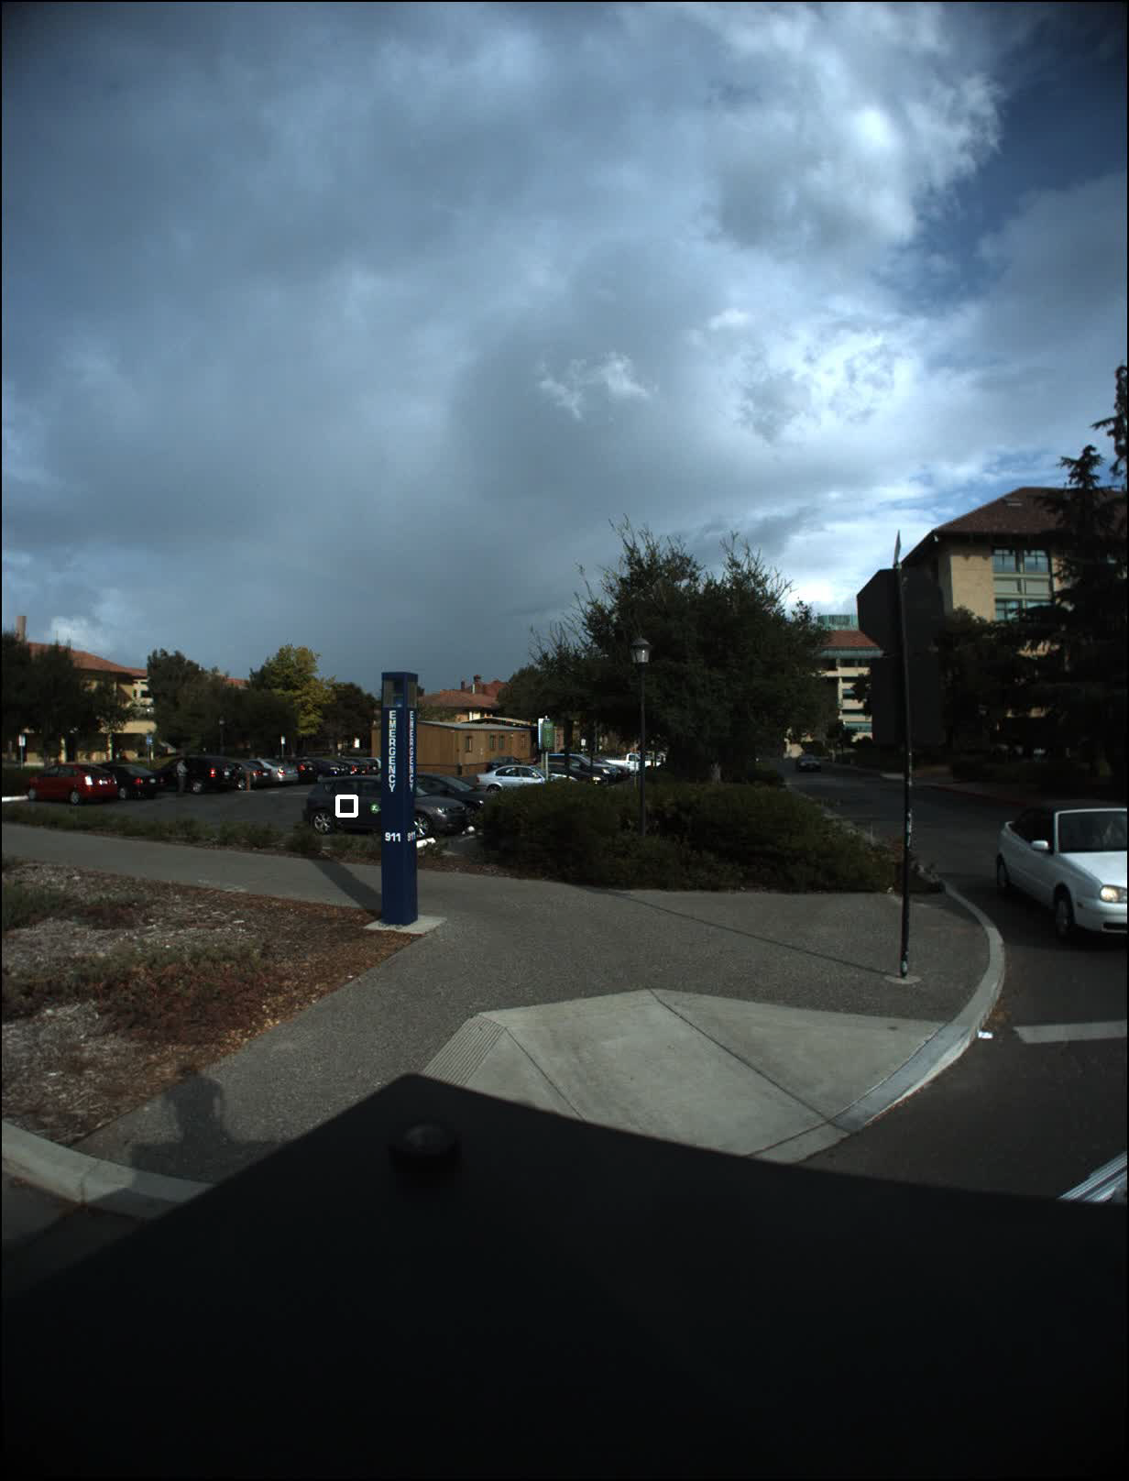

Slide 43
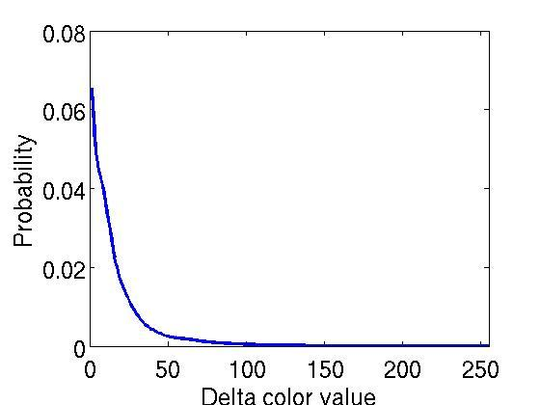
Color Probability
Probability
Delta Color Value

Slide 44
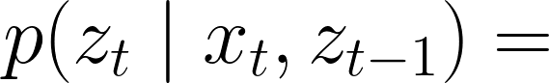
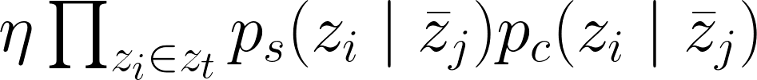
Including Color
Notes:
p(z_t \mid x_t, z_{t-1}) =
\eta\prod_{z_i \in z_t}p_s(z_i \mid \bar{z}_j)p_c(z_i \mid \bar{z}_j))
\eta (\prod_{z_i \in z_t} \exp (-\frac{1}{2}(z_i - \bar{z}_j)^T \Sigma^{-1} (z_i - \bar{z}_j))+k)
p(C)p(z_t \mid \bar{z}_j,V,C) +P(\neg C)p(z_t \mid \bar{z}_j,V,\neg C)
1-p_c \exp(\frac{-r^2}{2\sigma_c^2})

Slide 45
Including Color
Notes:
p(z_t \mid x_t, z_{t-1}) =
\eta\prod_{z_i \in z_t}p_s(z_i \mid \bar{z}_j)p_c(z_i \mid \bar{z}_j))
\eta (\prod_{z_i \in z_t} \exp (-\frac{1}{2}(z_i - \bar{z}_j)^T \Sigma^{-1} (z_i - \bar{z}_j))+k)
p(C)p(z_t \mid \bar{z}_j,V,C) +P(\neg C)p(z_t \mid \bar{z}_j,V,\neg C)
1-p_c \exp(\frac{-r^2}{2\sigma_c^2})

Slide 46
Including Color
Notes:
p(z_t \mid x_t, z_{t-1}) =
\eta\prod_{z_i \in z_t}p_s(z_i \mid \bar{z}_j)p_c(z_i \mid \bar{z}_j))
\eta (\prod_{z_i \in z_t} \exp (-\frac{1}{2}(z_i - \bar{z}_j)^T \Sigma^{-1} (z_i - \bar{z}_j))+k)
p(C)p(z_t \mid \bar{z}_j,V,C) +P(\neg C)p(z_t \mid \bar{z}_j,V,\neg C)
1-p_c \exp(\frac{-r^2}{2\sigma_c^2})

Slide 47
Including Color
Notes:
p(z_t \mid x_t, z_{t-1}) =
\eta\prod_{z_i \in z_t}p_s(z_i \mid \bar{z}_j)p_c(z_i \mid \bar{z}_j))
\eta (\prod_{z_i \in z_t} \exp (-\frac{1}{2}(z_i - \bar{z}_j)^T \Sigma^{-1} (z_i - \bar{z}_j))+k)
p(C)p(z_t \mid \bar{z}_j,V,C) +P(\neg C)p(z_t \mid \bar{z}_j,V,\neg C)
1-p_c \exp(\frac{-r^2}{2\sigma_c^2})

Slide 48
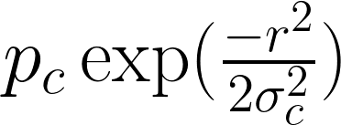
Including Color
Notes:
p(z_t \mid x_t, z_{t-1}) =
\eta\prod_{z_i \in z_t}p_s(z_i \mid \bar{z}_j)p_c(z_i \mid \bar{z}_j))
\eta (\prod_{z_i \in z_t} \exp (-\frac{1}{2}(z_i - \bar{z}_j)^T \Sigma^{-1} (z_i - \bar{z}_j))+k)
p(C)p(z_t \mid \bar{z}_j,V,C) +P(\neg C)p(z_t \mid \bar{z}_j,V,\neg C)
1-p_c \exp(\frac{-r^2}{2\sigma_c^2})

Slide 49
Including Color
Probability
Delta Color Value
Notes:
p(z_t \mid x_t, z_{t-1}) =
\eta\prod_{z_i \in z_t}p_s(z_i \mid \bar{z}_j)p_c(z_i \mid \bar{z}_j))
\eta (\prod_{z_i \in z_t} \exp (-\frac{1}{2}(z_i - \bar{z}_j)^T \Sigma^{-1} (z_i - \bar{z}_j))+k)
p(C)p(z_t \mid \bar{z}_j,V,C) +P(\neg C)p(z_t \mid \bar{z}_j,V,\neg C)
1-p_c \exp(\frac{-r^2}{2\sigma_c^2})

Slide 50
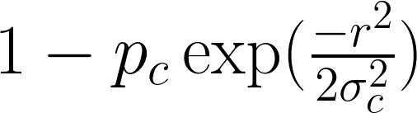
Including Color
Probability
Delta Color Value
Notes:
p(z_t \mid x_t, z_{t-1}) =
\eta\prod_{z_i \in z_t}p_s(z_i \mid \bar{z}_j)p_c(z_i \mid \bar{z}_j))
\eta (\prod_{z_i \in z_t} \exp (-\frac{1}{2}(z_i - \bar{z}_j)^T \Sigma^{-1} (z_i - \bar{z}_j))+k)
p(C)p(z_t \mid \bar{z}_j,V,C) +P(\neg C)p(z_t \mid \bar{z}_j,V,\neg C)
1-p_c \exp(\frac{-r^2}{2\sigma_c^2})

Slide 51
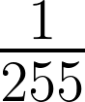
Including Color
Probability
Delta Color Value
Notes:
p(z_t \mid x_t, z_{t-1}) =
\eta\prod_{z_i \in z_t}p_s(z_i \mid \bar{z}_j)p_c(z_i \mid \bar{z}_j))
\eta (\prod_{z_i \in z_t} \exp (-\frac{1}{2}(z_i - \bar{z}_j)^T \Sigma^{-1} (z_i - \bar{z}_j))+k)
p(C)p(z_t \mid \bar{z}_j,V,C) +P(\neg C)p(z_t \mid \bar{z}_j,V,\neg C)
1-p_c \exp(\frac{-r^2}{2\sigma_c^2})

Slide 52
Probabilistic Framework
3D Shape
Color
Motion History
Tracking

Slide 53
Tracking Probability
P₁
P₂
P₃
P₄

Slide 54
Tracking Probability
v_{y}
?
?
?
?
?
v_{x}

Slide 55
Tracking Probability
v_{y}
v_{x}

Slide 56
Dynamic Decomposition
v_{y}
v_{x}

Slide 57
Dynamic Decomposition
v_{y}
v_{x}

Slide 58
Dynamic Decomposition
v_{y}
v_{x}

Slide 59
Dynamic Decomposition
v_{y}
v_{x}
Derived from minimizing KL-divergence between approximate distribution and true posterior

Slide 60
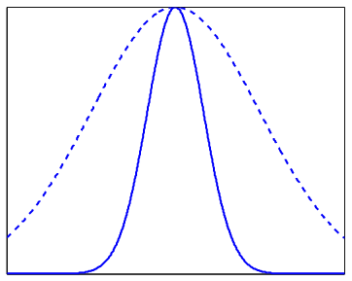
Annealing
Inflate the measurement model

Slide 61
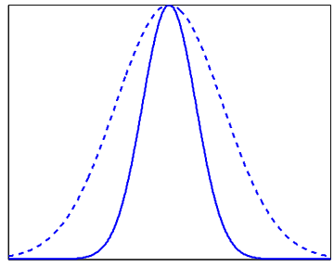
Annealing
Inflate the measurement model

Slide 62
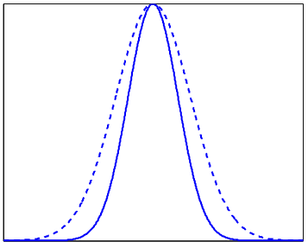
Annealing
Inflate the measurement model

Slide 63
Algorithm
For each hypothesis
Compute the probability of the alignment
Measurement
Model
Motion Model

Slide 64
Algorithm
For each hypothesis
Compute the probability of the alignment
Finely sample high probability regions
Measurement
Model
Motion Model

Slide 65
Algorithm
For each hypothesis
Compute the probability of the alignment
Finely sample high probability regions
Go to step 1 to compute the probability of new hypotheses
Measurement
Model
Motion Model

Slide 66
Annealing
More time
More accurate

Slide 67
Anytime Tracker

Slide 68
Anytime Tracker
Choose runtime based on:
Total runtime requirements
Importance of tracked object
...

Slide 69
Comparisons

Slide 70
Comparisons

Slide 71
Comparisons

Slide 72
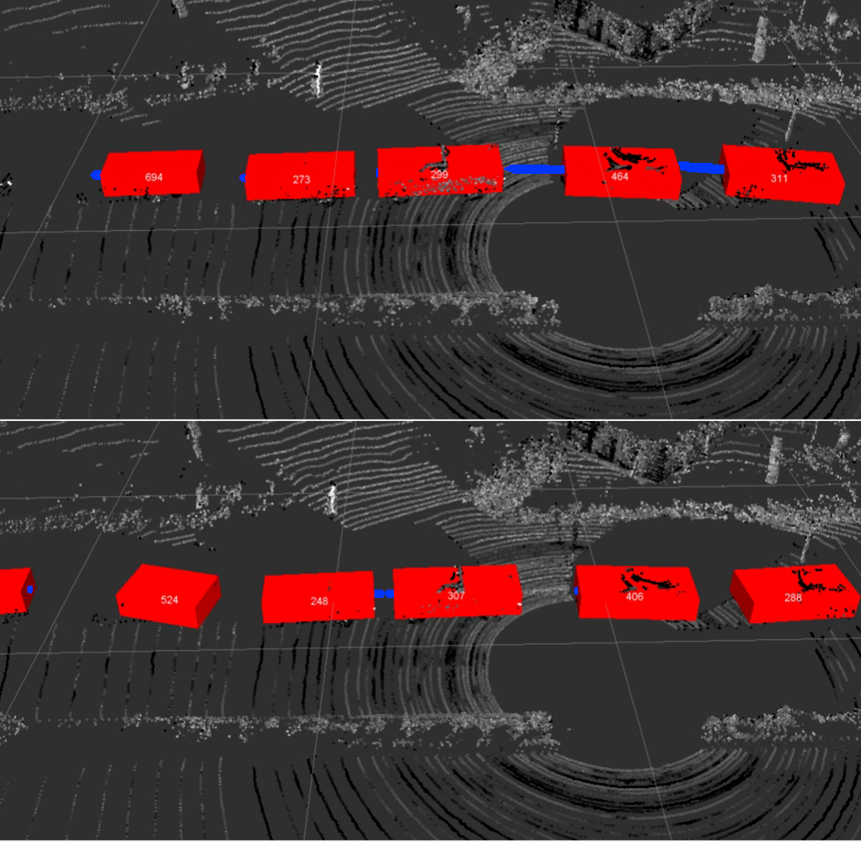
Kalman
Filter

Slide 73
Kalman
Filter
ADH Tracker
(Ours)

Slide 74
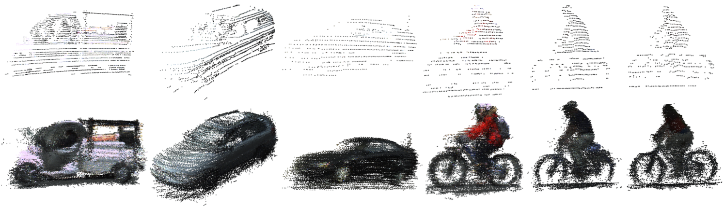
Models

Slide 75
Quantitative Evaluation 2

Slide 76
Sampling Strategies

Slide 77
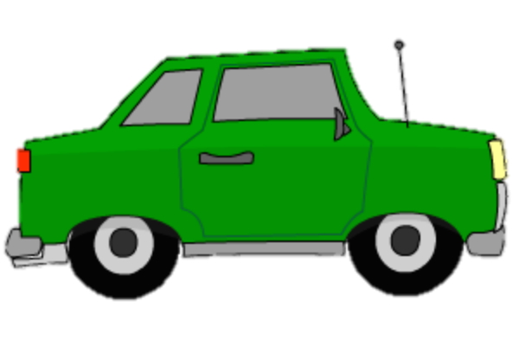
Advantages over Radar

Slide 78
Conclusions
3D Shape
Color
Motion History
Tracking
Robust to Occlusions, Viewpoint Changes
Notes:
Add figures and illustrations for these points

Slide 79
Conclusions
3D Shape
Color
Motion History
Tracking
Robust to Occlusions, Viewpoint Changes
Runs in Real-time
Robust to Initialization Errors
Notes:
Add figures and illustrations for these points

Slide 81
Color Probability
Probability
Delta Color Value

Slide 82
Error vs Number of Points

Slide 83
Error vs Distance

Slide 84
Error vs Number of Frames

Slide 85
Error vs Number of Frames

